Slide 1
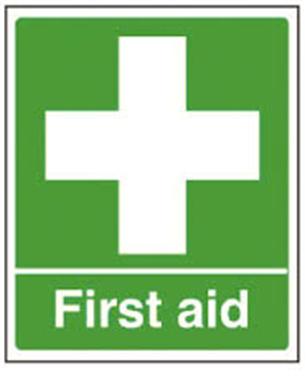
Ralph Talabi–
07951779192
Emergency 999
National non-emergency 111
Emergency number 112 will work on any mobile
Non Emergency Police 101

