Slide 1
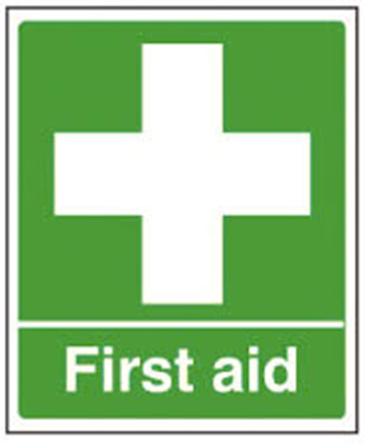
Rob Walker -
07864 021125
Emergency 999
National non-emergency 111
Emergency number 112 will work on any mobile
Non Emergency Police 101

