Slide 1
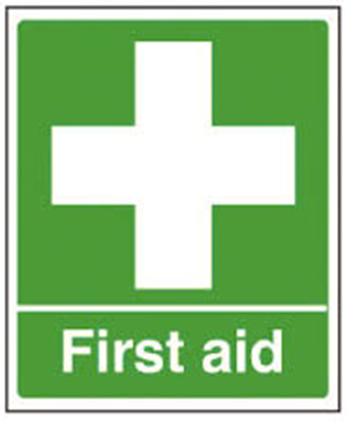
Nici Moran – 07729 015953
Emergency 999
National non-emergency 111
Emergency number 112 will work on any mobile
Non Emergency Police 101

